Slide 1

Moving into the mainstream:
Embedding research skills within a core academic course
Fiona Willans, Ralph Buadromo, Tilisi Bryce, Rajendra Prasad
Funded by the Centre for Flexible Learning (TEL project)

Slide 2








Traditional academic course
Embedded course design
S.L.S.
LIBRARY
Research skill development
English proficiency development
Help with English?
Help with research?
Discipline content
Discipline content
Academic literacy development
Help with academic skills?
“That’s not my job.”
“There’s not enough time.”
Discipline specialist
UU114
Academic English
(McWilliams & Allan, 2014; Purser et al, 2008; Thies, 2012; Wingate, 2006, 2015; Wingate et al, 2011)

Slide 3
Course design (Intro Linguistics)
Topic overview | Preparing for lectures | Online lectures | Reading key texts | Exploring ideas | Focusing on communication | Tutorial activities | Working towards assignments
0.5 hours | 1 hour | 1 hour | 1.5 hours | 1 hour | 1hour | 2 hours | 2 hours
Week 4: The languages of the world | Listening for main ideas and specific details | Language families | Identifying relevant parts of a text for an assignment | Searching the Ethnologue | Articles, quantifiers and plurals | Attacking challenging paragraphs | Clarifying criteria for Assignment 2
Week 5: Languages & dialects | Making good use of outline slides | Languages & dialects | Taking effective notes | Searching language archives | Main clauses and subordinate clauses | Summary writing | Planning Assignment 2
Week 6: Language change | Applying, analysing & evaluating ideas from lectures | How and why do languages change? | Linking ideas from different texts | Searching the Oxford English Dictionary online | Tense and aspect | Referencing your work | Completing a first draft of Assignment 2

Slide 4
Assessment guidelines
Clarify the task
Find relevant information
Evaluate that information
Analyse & synthesise ideas
Reference ideas appropriately
Organise ideas
Express ideas clearly
Online lectures
Readings
‘Effective communication’ notes & quizzes
‘Exploring ideas’ tasks
RSD outcomes
Learner experience:
Are they accessing materials?
Are they completing materials?
Do they see their value?
Do they find them user-friendly?
Do they find them effective?
Do they face time or tech constraints?
Academic literacy development:
Do they apply what they learn?
Do they retain such learning?
Tutorial activities
(F2F or Online)
RSD Framework
Course design
Evaluation 1
Evaluation 2

Slide 5
RSD (1) “Exploring ideas”
Section | Type of resource | Examples
Section 1 | Non-academic resources about language | Blogs, podcasts, video channels Media, social media
Section 2 | Primary sources of linguistic data | Database of the world’s languages Archival data Online dictionaries Online corpus tools
Section 3 | Secondary academic sources about language | Library resources Responsible use of Google & friends
SEARCH
SELECT
REPORT BACK
JUSTIFY

Slide 6
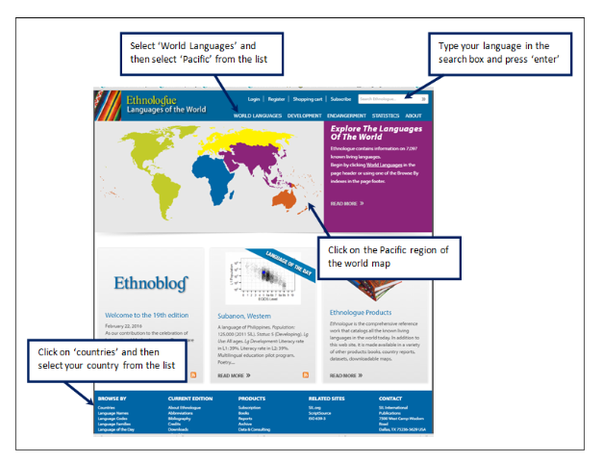


RSD (1) “Exploring ideas”: An ideal post

Slide 7

More typical posts …

Slide 8
RSD (2) Activities to support assignments
Assessments | Research skill outcomes
Assignment 1: Unseen writing assessment
Assignment 2: Summary based on 3 prescribed texts | Identify relevant extracts from prescribed texts Take effective notes on these extracts Synthesise ideas from different texts Reference ideas appropriately
Assignment 3: Group oral presentation | Search for sources of information Evaluate relevance and credibility of sources Explain to an audience with no knowledge of topic
Assignment 4: Individual essay plan & bibliography | Plan an extended piece of research-based writing Justify selection of secondary sources
Assignment 5: Individual written essay | Organise ideas from sources to form a position Support this position with reference to the sources

Slide 9
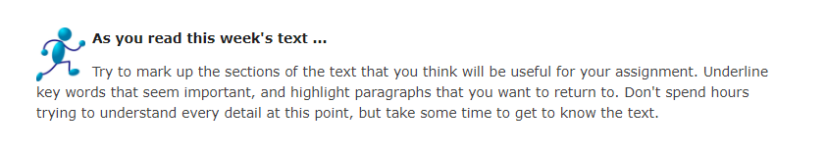
RSD (2) Activities to support assignments

Slide 10
RSD (2) Activities to support assignments
Reflect on your understanding of the extract:
 |  | TICK ONE
A | I am confused about the point that Mühlhäusler is making in the extract.
B | I understand that Mühlhäusler thinks there is a problem with the way Westerners (including linguists) describe languages, but I can’t explain why.
C | I can explain why Mühlhäusler thinks there is a problem with the way Westerners (including linguists) describe languages. | ✓
D | I can provide examples from my own experience or knowledge to illustrate the point that Mühlhäusler is making.

Slide 11
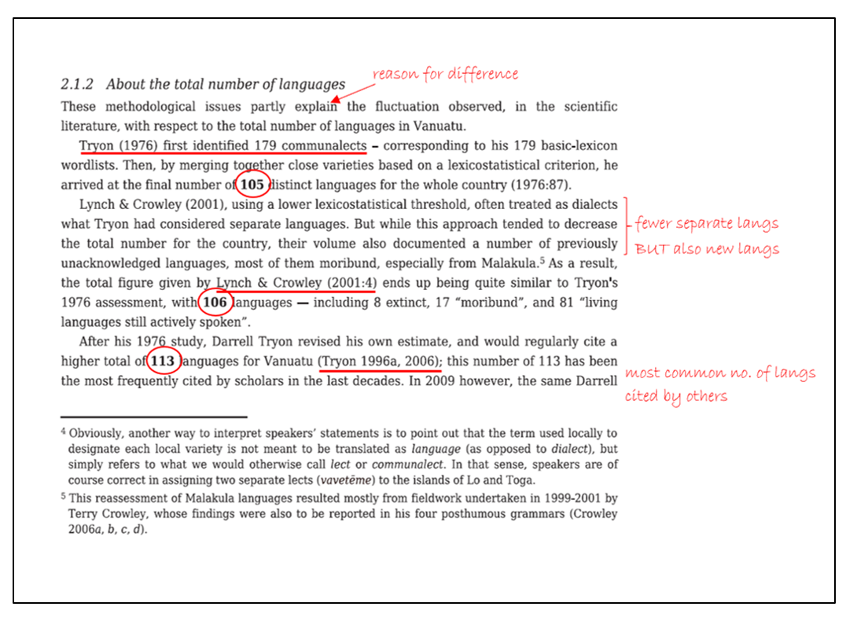
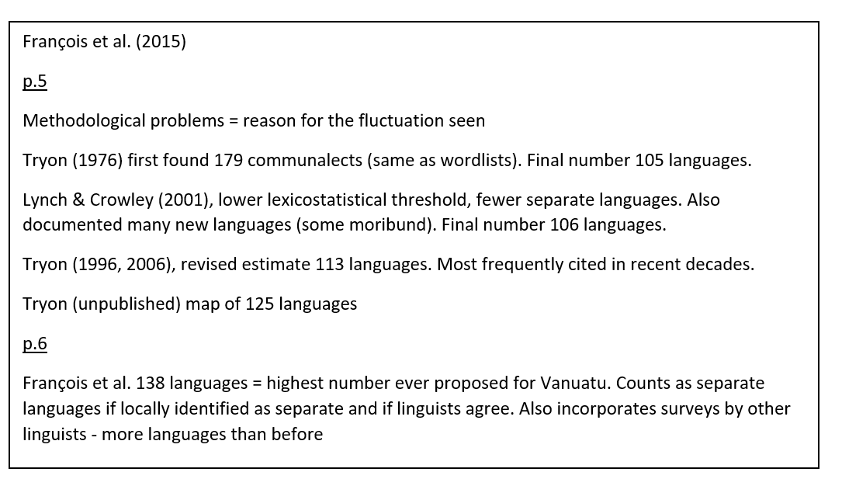

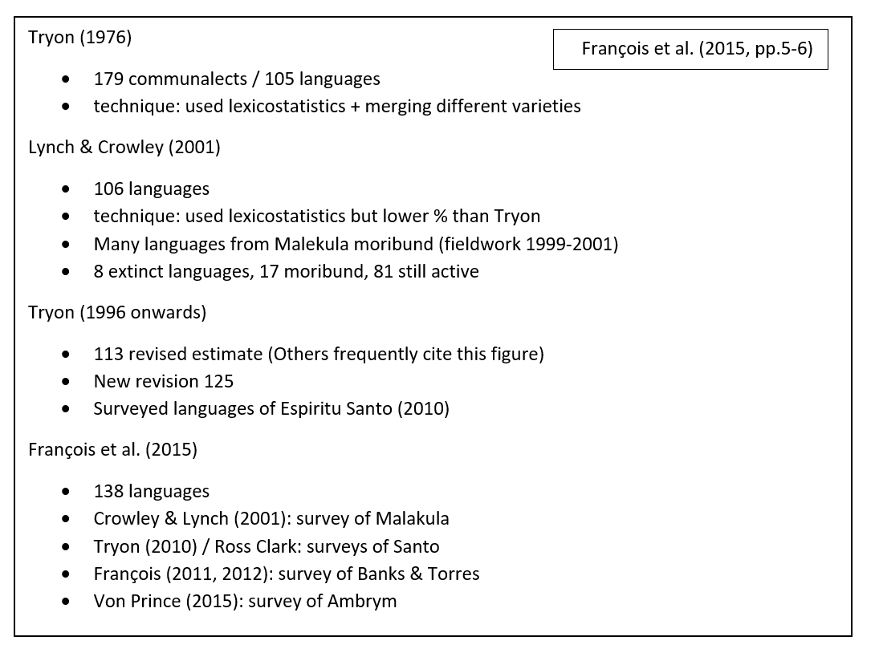
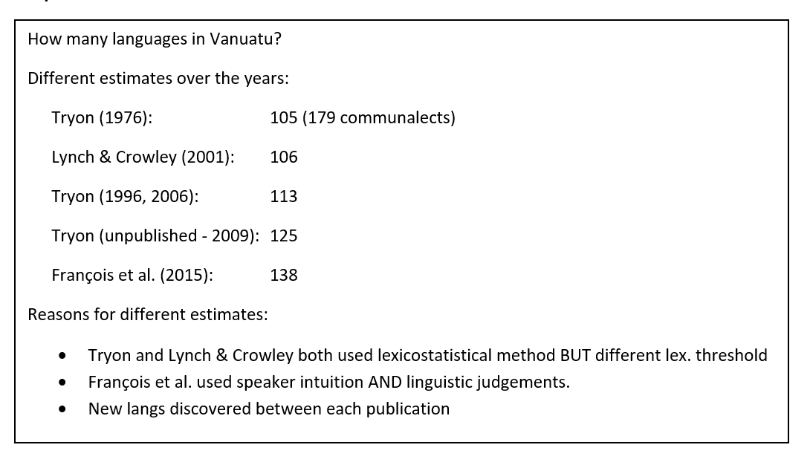
RSD (2) Activities to support assignments
Evaluate these sets of notes based on the extract from the text:

Slide 12

RSD (2) Activities to support assignments
Why use other sources of information?
I can’t think of a good answer to the question, so I use other ideas to help me think of something. I then rephrase these other ideas because it’s important to use my own words. Other students may be able to answer the question by themselves, but I need help.
I decide what I think about the question first, and then I look for ideas from other sources that can back up my opinion. I use the references to show how much I have read.
I read around the topic first, and gradually build up my own answer to the question once I’ve read enough. There is no single right answer to the question, but I use references to show the reader how I have arrived at my particular answer.

Slide 13

RSD (2) Activities to support assignments
Add in-text citations to the following paragraph, using p.4 of the Week 5 reading and p.20 of the Week 6 reading:

Slide 14
Analytics (1) “Exploring ideas” tasks

Slide 15
Analytics (2) Support for Assignment 2

Slide 16
Analytics (3) Overall activity

Slide 17
Limitations of analytics data
Lack of baseline data
Averages tell us little about what is really going on
More clicks = More engagement? Or trouble finding the materials?!
Multiple variables that may influence “engagement”

Slide 18
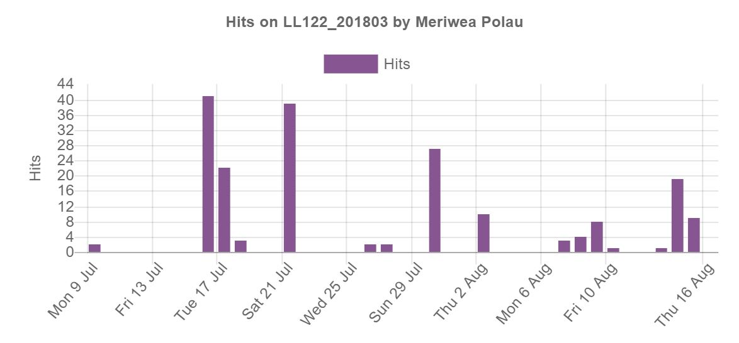
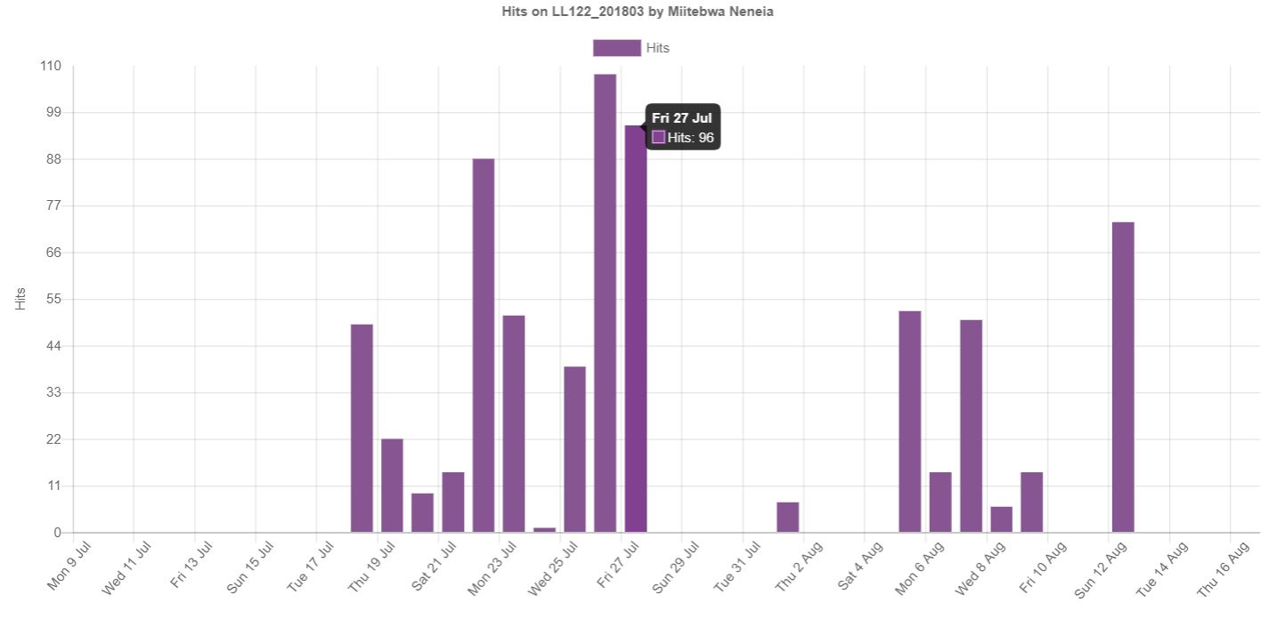
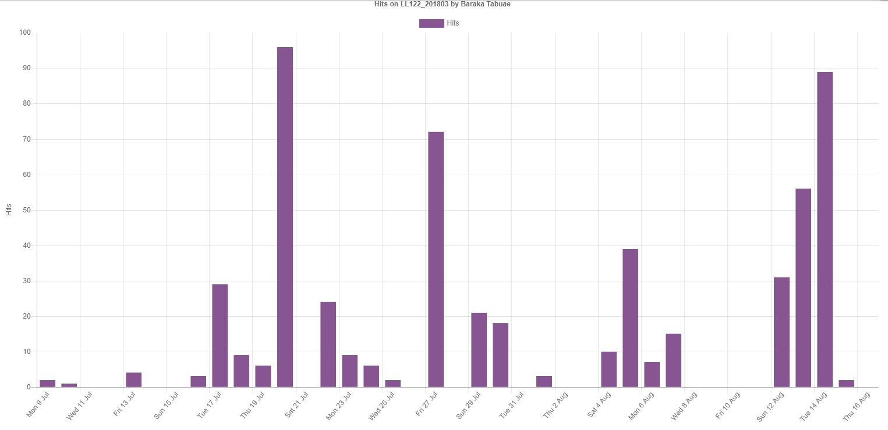
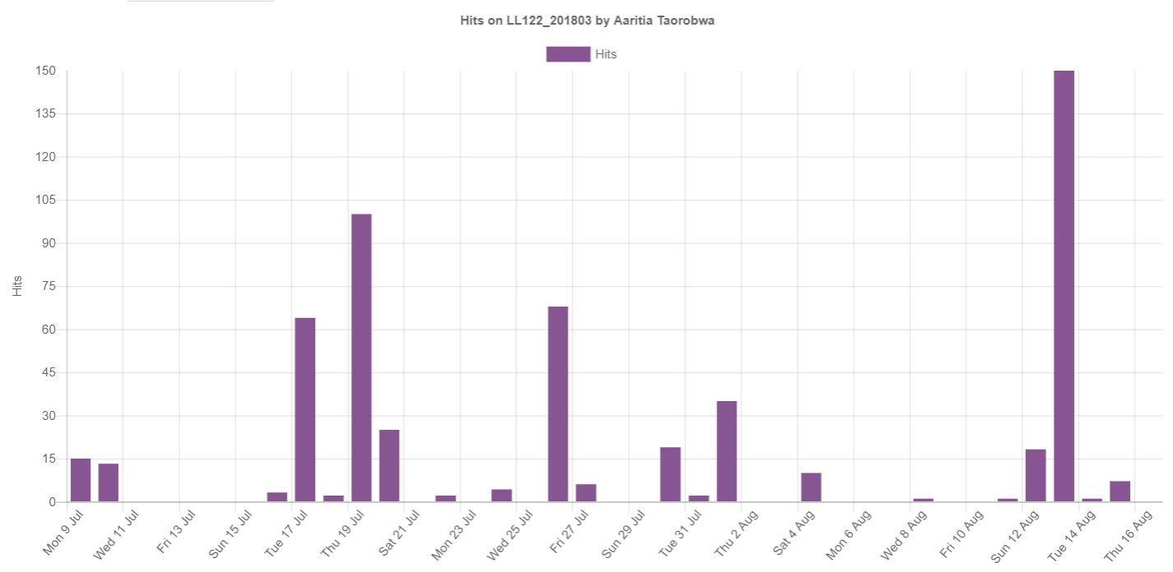
Zooming in … Asking students about their work patterns
Student 1
Student 2
Student 3
Student 4

Slide 19

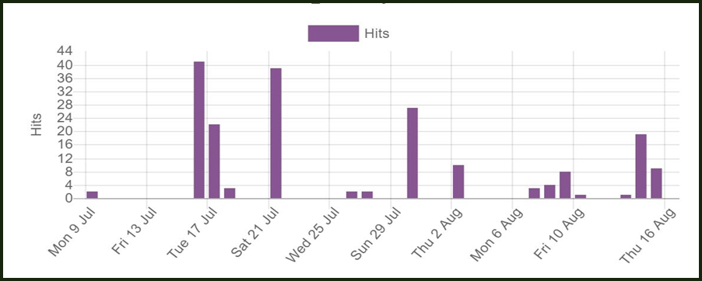
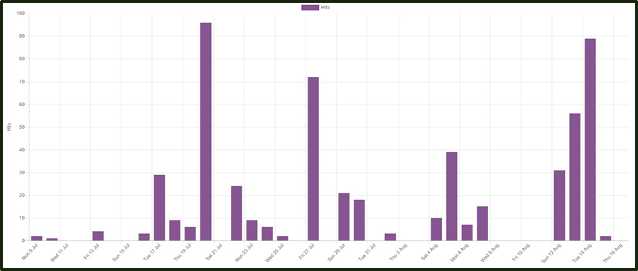
Zooming in …

Slide 20
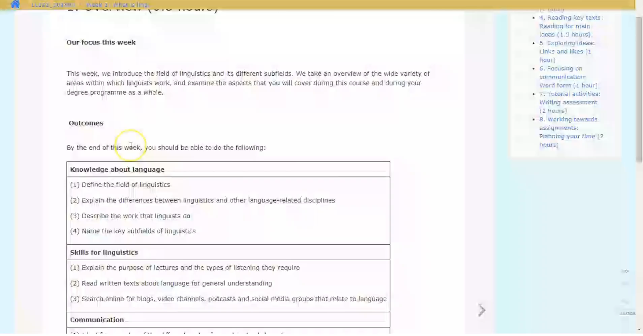
Seeing Moodle from the student’s perspective

Slide 21
Student perceptions of RSD support
Students who are navigating successfully:
“We learn to search for information that is relevant to us, and then it’s up to us what we say about it.”
“They give us the sites and readings that they want us to look at, so we learn which are credible sources.”
“They show us how to find the right paragraphs, and then how to find the right information inside them, and then how to summarise it. I can transfer these methods to my Education and Economics courses.”
“I was doing an assignment last night for another course. I’d just finished a tutorial from LL122 on how to use sources, and I realised I could use the same approach.”
“I’ve learnt why direct quotations from the readings don’t really help me answer my assignment question.”

Slide 22
Summary … so far
Positive early signs of engagement with academic literacy materials for those who are completing all activities
Still a large number of students who are not completing these activities that are designed to support them … Need to address this issue
Next step … correlations between engagement with materials and achievement of RSD outcomes …
Vinaka vakalevu!
Tangkiu tumas!
Kam rabwa!
Dhanbaad!

Slide 23
References
McWilliams, R., & Allan, Q. (2014). Embedding academic literacy skills: Towards a best practice model. Journal of University Teaching & Learning Practice, 11(3), 1-20.
Purser, E., Skillen, J., Deane, M., Donohue, J., & Peake, K. (2008). Developing academic literacy in context. Zeitschrift Schreiben: Schreiben in schule, hochschule und beruf, 1-7.
Thies, L. (2012). Increasing student participation and success: Collaborating to embed academic literacies into the curriculum. Journal of Academic Language and Learning, 6(1), 15-31.
Wingate, U. (2006). Doing away with study skills. Teaching in Higher Education, 11(4), 457-465.
Wingate, U. (2015). Academic literacy across the curriculum: towards a collaborative instructional approach. Paper presented at the International Conference on English Across the Curriculum, Hong Kong Polytechnic University.
Wingate, U., Andon, N., & Cogo, A. (2011). Embedding academic writing instruction into subject teaching: A case study. Active Learning in Higher Education, 12, 69-81.

